Slide 1

DEPARTMENT OF COMPUTER SCIENCE & ENGINEERING
SDM INSTITUTE OF TECHNOLOGY
Synopsis Presentation on Final Year Project
“malicious web content detection”
Under the guidance of
Mr. Chintesh R
Asst.Professor
Department of CSE
SDMIT, Ujire
Presented By
1.POOJARI BRIJESH R, 4SU17CS059
2.MAHAMMAD SHAMEER, 4SU17CS038
3.NISHANTH BS, 4SU17CS052
4.NIPUN HEGDE,4SU17CS049
TEAM ID: 2021CSEP02

Slide 2
Contents
Introduction
Problem Statement
Objectives
Methodology
Result Analysis
Conclusion
References

Slide 3
Introduction
The web attacks are the challenging issues of the web community. When the user visits the malicious web site the attack is initiated through various features (lexical, domain, path, web content and hyperlink etc). To prevent the user against accessing the malicious websites, several automated analysis and detection methods have been proposed .
The attackers lure the visitor to access malicious web sites and they steal crucial information from the client machine or install the spyware for further exploits. Dynamic HTML gives attackers a new and powerful technique to compromise the security of computer systems.
A malicious dynamic HTML code is usually embedded in a normal webpage. The malicious webpage infects the victim when a user browses it. Furthermore, such DHTML code can disguise itself easily through transformation, which makes the detection even harder.

Slide 4
PROBLEM STATEMENT
All kinds of malicious web pages seriously threat the users’ computer security. To avoid attacks from malicious web pages, it is required an efficient malicious webpage detection systems to detect a webpage before user browses it. It is required an efficient malicious webpage detection systems to detect a webpage before user browses it, and stop opening malicious webpage using machine learning.

Slide 5
Objectives

Slide 6
Methodology
The Malicious Web Content Detection consists of four main steps: Obtaining Dataset, Feature Selection, Choosing Classification Algorithm and Google Chrome Extension.
In general, the system works as follows: The dataset was obtained from the UCI - Machine Learning Repository.
Next, From the dataset, out of the 30 features present, it was infeasible to extract all the features.Some of them URL Length, Google Index.
After that, For classifying the URL entered, as either safe or malicious, we considered the following three algorithms: K-Nearest Neighbours (KNN), Support Vector Machine (SVM) Random Forest .
Finally Chrome Extensions are add-ons to the browser which help in adding more features and making browser usage easier for the user.

Slide 7
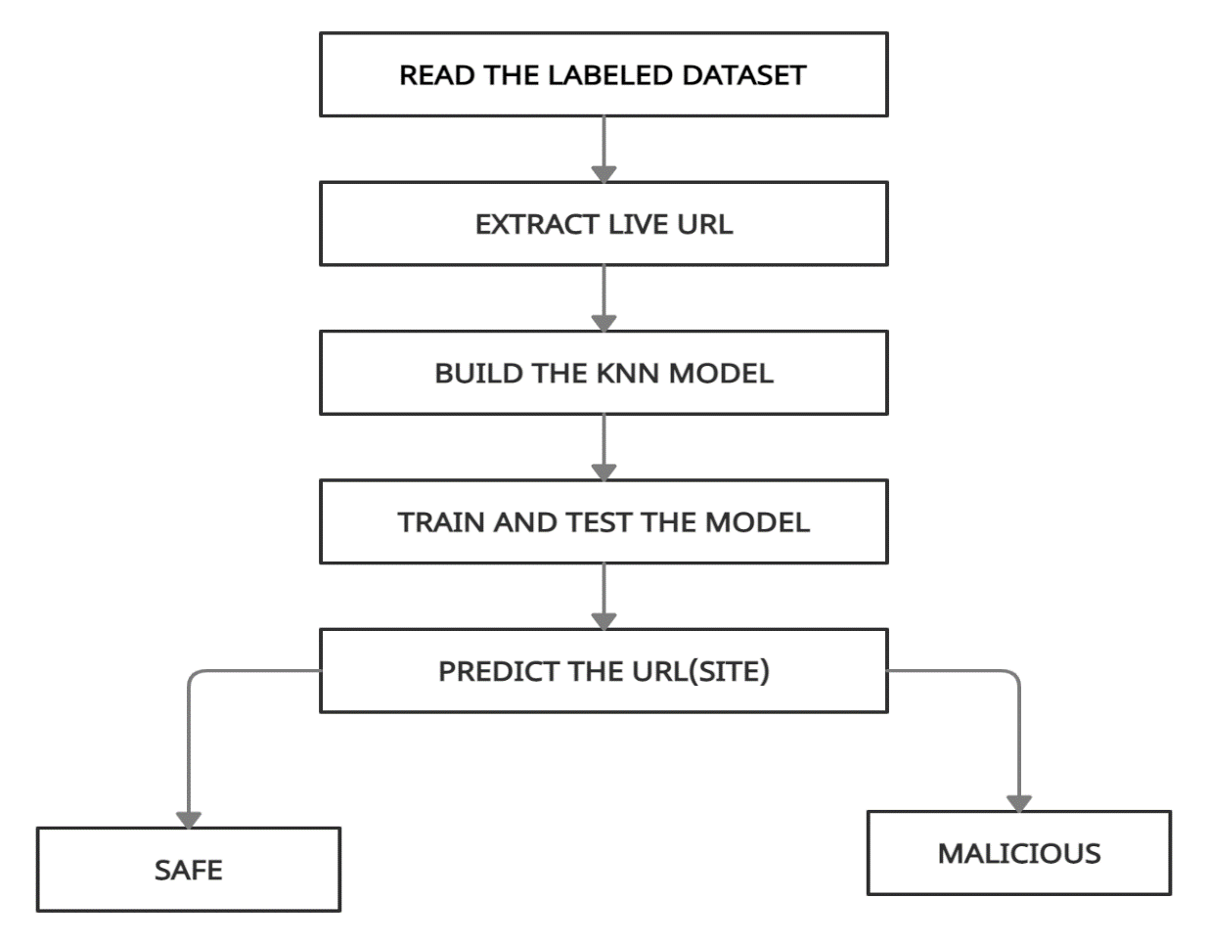
Architecture of proposed approach
A Classiﬁer is used to distinguish malicious pages from beginning ones. We collected web pages from the Internet to be the training data for the Classiﬁer. The data are processed through a feature extraction engine to get the features for the Classiﬁer. The framework is shown in Fig. 1
Fig 1. A general processing framework for malicious URL Detection Using ML

Slide 8
Result Analysis

Slide 9
Conclusion
The project displays the safety component of a website to keep the user safe. Otherwise, the user might end up giving his credentials to the attackers which can lead to huge losses
This project proposes the development of a chrome Extension for identifying malicious websites.
The future scope of this idea is very broad. Some websites only have a few components , one can block this malicious part and display the complete safe webpage to the users.
This can be implemented in a similar as to that of AdBlock Extension which blocks a particular part of the webpage and displays the rest.

Slide 10
References
Anand Desai, Janvi Jatakia, Rohit Naik and Natasha Raul “Malicious Web Pages Detection Technique using Identifying Vulnerable Websites by Analysis of Common Strings in Phishing URLs
B. Wardman, G. Shukla and G. Warner, ;”Identifying vulnerable web_x0002_sites by analysis of common strings in phishing URLs,”; 2009 eCrime Researchers Summit, Tacoma, WA, 2009, pp. 1-13.
A. B. Sayambar, A. M. Dixit, “On URL Classification, International Journal of Computer Trends and Technology” 2014.
Xiang et al., “A Feature-Rich Machine Learning Framework for Detecting Phishing WebSites, ACM Transactions on Information and System Security “2011.
Hou et al., “Malicious Web Content Detection by Machine learning, Expert Systems with Applications”, International Journal 2010.

Slide 11
James, Joby, L. Sandhya, and Ciza Thomas, ”Detection of phishing URLs using machine learning techniques,” Control Communication and Computing (ICCC), 2013 International Conference on. IEEE, 2013.
Khamis et al, “Characterizing A Malicious Web Page”, Australian Journal of Basic and Applied Sciences 2014.
Curtsinger et al., “Zozzle: Fast and Precise In-Browser JavaScript Mal_x0002_ware Detection”, SEC’11 Proceedings of the 20th USENIX conference on Security 2011.

